Slide 1

ESSENTIAL OILS
CHEM SEC 204TH
Department of Chemistry
Government College
Paonta Sahib (HP)

Slide 2
Topics
ESSENTIAL OILS
CLASSIFICATION OF ESSENTIAL OILS
CHARACTERISTICS OF ESSENTIAL OILS
THE COMPOSITION, PROPERTIES AND USES OF SOME ESSENTIAL OILS
EUGENOL

Slide 3
ESSENTIAL OILS
Essential oils are volatile, odoriferous substances obtained from fruits, flowers, leaves and roots of various plants.
Plants containing essential oils usually have the greatest concentration at some particular time, for example, jasmine at sunset.
Hence, it is better to take the plant parts having essential oils at this particular time.
Essential oils in the life of plants are probably connected with metabolism, fertilization or protection from enemies

Slide 4
CHARACTERISTICS OF ESSENTIAL OILS
Essential oils are generally insoluble in water but soluble in organic solvents.
The oils are volatile with steam and are also volatile enough to distill unchanged in most cases.
They vary from colourless to yellow or brown in colour.
An essential oil is usually a mixture of compounds (oil of winter green, is almost pure methyl salicylate).
They are optically active substances. The refrative index of these oils is high (about 1.5).

Slide 5
CLASSIFICATION OF ESSENTIAL OILS
They are generally the mixture of different compounds such as alcohols, aldehydes, esters, acids, ketones, phenols, lactones and hydrocarbons. The compounds occurring in essential oils may be classified as follows:
Esters (derivatives of carboxylic acids): Benzoic, acetic, salicylic and cinnamic acids.
Alcohols: Linalool, geraniol, citronellol, terpineol, menthol and borneol.
Aldehydes: Citral, citraonellal, benzaldehyde, cinnamaldehyde, cuminic aldehyde, vanillin.

Slide 6
Phenols: Eugenol, thymol, carvacrol.
Acids: Benzoic, cinnamic, myristic, isovaleric acids.
Lactones: Coumarin.
Terpenes: Camphene, pinene, lemonene, cedrene, phellandrene.
Hydrocarbons: Styrene, cymene.
Esters: Cineole, eucalyptole (internal ether), safrole, anethole

Slide 7
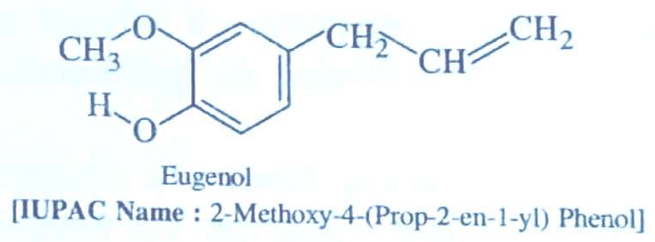
THE COMPOSITION, PROPERTIES AND USES OF SOME ESSENTIAL OILS
EUGENOL
It is a colorless to pale yellow, aromatic (aroma) oily liquid extracted from certain essential oil especially from clove oil, nutmeg, cinnamon, basil or bay leaves.

Slide 8
Chemical Composition:
It is an aromatic organic compound which has ether, alcoholic groups in it and a small unsaturated side chain.
Natural sources:
Eugenol is naturally occurring in several plants.
Cloves are one of the richest sources of eugenol.The clove bud oil and clove leaf oil contain 80-90% of eugenol.
The plants which are source of eugenol are, worm wood, cinnamon, nutmeg, lemon balm, bay leaf ginger etc.

Slide 9
Uses of Eugenol
It is used as a local antiseptic and anaesthetic.
It is used in manufacture of perfumes, flavorings and essential oils.
Eugenol can be combined with zinc oxide to form zinc oxide eugenol which has restorative and prosthodontic applications in dentistry especially in root canal sealing.
It can be used to reduce the presence of Listeria monocytogene and Lactobacilluy salkei in food.
It is used in manufacturing stabilizers and antioxidants for plastic and rubber.
It is growing popularity as anaesthetic and used on aquarium fish as well as on wild fish when samples are required for research and management purposes.

Slide 10


